Slide 1


Full Stack Development 30 Days Challenge
Develop a Real-time NETFLIX Website
Day 6/30

Slide 2
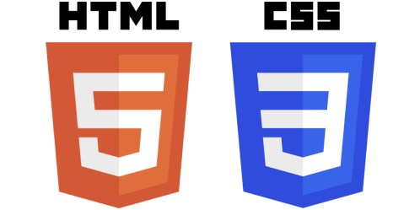

Slide 3
“Find Your Self”
CURIOUS
WHILE LEARNING

Slide 4
CSS POSITION
The Position property in CSS determines how an element is placed in the document flow
Allow precise control over its position.

Slide 5
TYPES OF CSS POSITION
Static: The element stays in the normal page order.
Relative: The element moves slightly from its normal spot.
Absolute: The element moves inside its closest container.
Fixed: The element stays in the same place on the screen, even when you scroll.
Sticky: The element sticks to the top when you scroll past it.

Slide 6
Lets CODE

Slide 7
Thanks!

